Slide 1
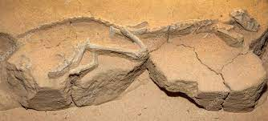
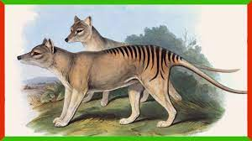
The Tasmanian Tiger
The Linnaean Name is “Thylacinus cynocephalus”
Thylacines preferred kangaroos and other marsupials, small rodents and birds.
They ranged over grasslands, wetlands, and dry eucalyptus forests.
Thylacines likely lived five to seven years in the wild, though they lived up to nine years in captivity.
I picked this animal because of its uniqueness and its role in the culture of the people in Tasmania.
The Tasmanian Tiger helped maintain local ecosystems by suppressing invading predators.

